Slide 1
Types of Governments
Grade 7
Social Studies Online Presentation

Slide 2
Distribution of Power
Federal
Nat’l govt. is
In power
Unitary
One central govt.
Local
Local
Confederation
Local Gov is in power
Nat’l
Nat’l

Slide 3
Unitary Government System
The central government holds nearly all of the power. In a unitary system, local governments such as state or county systems may have some power, but they are all under the control of the central government.
Ex: A monarchy – Saudi Arabia is a monarchy

Slide 4
Confederation Government System
The local governments hold all of the power and the central government depends on the local governments for its existence.
Ex: League of Arab States: Established on March 22, 1945, the League of Arab States aims to strengthen political relations and facilitate cooperation among member states, as well as to "safeguard their independence and sovereignty."[1] Pursuant to the Arab Pact, the League's founding Charter, all "independent Arab states" are entitled to membership in the organization.[2] The League currently has 22 members - all of the Arab states;[3] and several non-Arab states have been invited to participate in its activities as observers

Slide 5
Federal Government System
Political system in which power is shared among different levels of government.
Power is divided into national and state governments
Israel has a federal form of government and has a democratic republic

Slide 6
Citizens Participation
Autocracy
Oligarchy
Democracy
Parliamentary Presidential
Votes Votes
Legislature Legislature &
President
(only one)
(small Group)
(Every one)

Slide 7
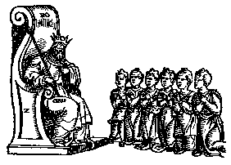
Autocracy
Government by a single person having unlimited power; despotism (domination through threat of punishment and violence) .

Slide 8
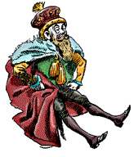
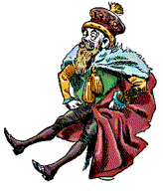
Monarchy
A monarchy has a king, queen, emperor or empress.
The ruling position can be passed on to the ruler’s heirs.
In some traditional monarchies, the monarch has absolute power.
Ex: Saudi Arabia

Slide 9
Oligarchy
A government in which a few people such as a dominant clan or clique have power.
Ex: Syria – in Syria, the ruling political party, the Ba’ath Party, controls much of the government
Ex: Iran – a small group of religious and political leaders make many of the decisions.

Slide 10
Republic
In a republic, the government is elected by the people. Everyone who is eligible to vote has a chance to have their say over who runs the country. It is distinct from governments controlled by a particular social class or group (aristocracy; oligarchy) or by a single person (despotism; dictatorship; monarchy).
A republic is determined either directly or through elected representatives.
Ex: Israel

Slide 11
Parliamentary Form of Democratic Government
The people vote for those who represent the political party they feel best represents their views of how the government should operate.
The legislature they elect, the Parliament, makes and carries out (enforces) the laws for the country.
The leader is often called the Prime Minister (Ex: UK – queen and prime minister, David Cameron)

Slide 12
Presidential Form of Democratic Government
Also called a congressional form of government. Here, a President, or chief executive, is chosen separately from the legislature.
The legislature passes the laws and it the duty of the president to see that the laws are enforced.
Ex: United States

